Slide 1
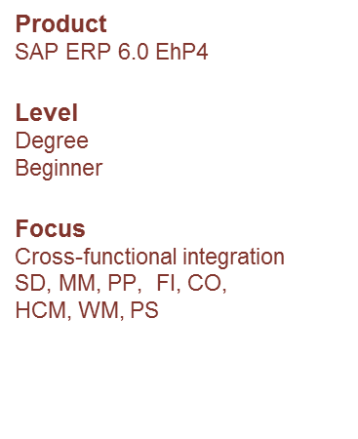
IBPSES
CT104-3-2-VD1
Module Overview
Abstract
This teaching material is intended to explain how the fundamental business processes interact with SAP ERP in functional areas such as Sales and Distribution, Materials Management, Production Planning, Financial Accounting, Controlling, and Human Capital Management.
Prepared by: KN First Prepared on: 01.08.12 Last Modified on: DD.MM.YY
Quality checked by: xxx
Copyright 2012 Asia Pacific University of Technology and Innovation

Slide 2
Lecturer Information
Lecturer Name: Nur Khairunnisha Zainal
Email: Khairunnisha.zainal@staffemail.apu.edu.my

Slide 3
Module Overview
Integrated Business Processes with SAP ERP System module approaches ERP topics using an integrated process perspective of the firm. Students will gain a deep appreciation for the role of enterprise systems in efficiently managing processes from multiple functional perspectives.
The module comprises lectures and lab sessions and involves independent learning skills within the practical exam

Slide 4
Module Learning Outcomes
On successful completion of this module, you should be able to:
Discuss the role of ERP system in optimizing and automate business processes (C2,PLO1)
Demonstrate the ability to extract meaningful information and execute business processes within an organization using ERP system (A3,PLO6)
Apply various integration points of business processes with ERP system (C3, PLO2)

Slide 5
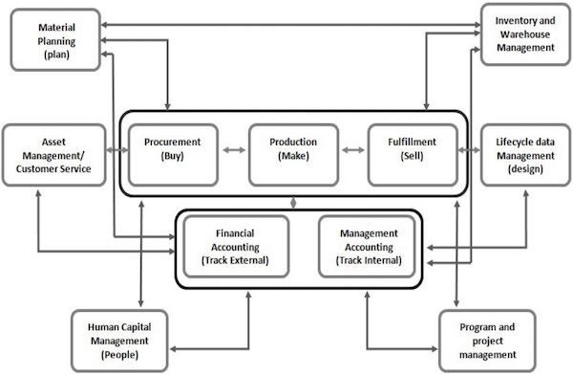
Topics we will cover
ERP

Slide 6
Topics we will cover
Week | Topic
Week 1 | Module Introduction Introduction to assignment details Assessments Briefing Introduction to the subject area
Week 2 | Chapter 1: Introduction to Enterprise system & SAP Introduction to Business Processes. Introduction to Enterprise Systems & SAP Data in Enterprise system GBI Story

Slide 7
Topics we will cover
Week | Topic
Week 3 &4 | Chapter 2: The Fulfilment Process
Week 5 | Chapter 3: Material Management
Week 6 | Chapter 4: Warehouse Management
Week 7 | Chapter 5: The Production Process
Week 8 | Chapter 6: Financial Accounting
Week 9 | Chapter 7: Management Accounting
Week 10 | Chapter 8: Human Resource Management

Slide 8
Topics we will cover
Week | Topic
Week 11 | Chapter 9: Enterprise system technologies
Week 12 | Integration: Procurement, Fulfilment, Production and IWM Processes
Week 13 | Revision
Week 14 | Exam

Slide 9
What is expected of you
You should abide to all the rules & regulation of APU
Wear a proper attire to class
No speaking of dialects
All hand phones should be turned off during lectures.
Participation in group-work / class-work
Student participation in class : Edmodo/Schoology/Ms.Teams, Lab Exercises, Class Activities: Quiz, Cross Word Puzzle, Case Study and etc.

Slide 10
What is expected of you
Attendance and Punctuality
Class attendance is an individual student responsibility.
Attendance is compulsory and valid medical certificates or letters from parents /guardians must support any absence from class.
Three lateness will be equal to one absence
Attendance:
Min 80% attendance requirement holds for BOTH Exam and IN COURSE based assessments.
Students have to Retake the module with attendance even if it’s a 100% coursework based assessment if they do not fulfil the minimum attendance requirement.
If there is a “No show” for the Exam, it will normally result in Retake with attendance

Slide 11
What support is available for you
Student Assessment Information Sheet (SAIS)
Module slides
Webspace
Microsoft Teams
Consultation hours (Lecturer consultation Hours)
E-mail
khairunnisha.zainal@apu.edu.my
Resources
Reference material
Essential reading
Additional reading

Slide 12
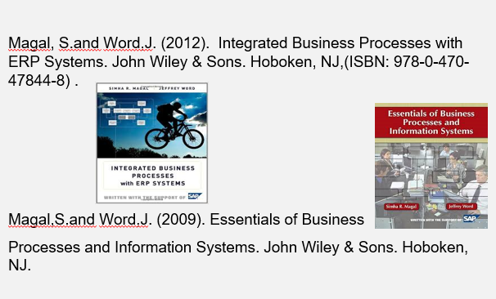
References supporting the course

Slide 13
How you will be assessed
70% in course Assessment
30% Final Exam

Slide 14
Question and Answer Session
Q & A

Slide 15
What we will cover next
SAP GUI installation
GBI Story

